Slide 1


FAST
National University of Computer and Emerging Sciences Peshawar
OOP Lab # 3.2
C++ Loops Instructor: Muhammad Abdullah Orakzai
DEPARTMENT OF COMPUTER SCIENCE
الذی علم بالقلم۔ علم الانسان ما لم يعلم۔

Slide 2
Contents
Control Structure/Loop
for loop
while loop
do-while loop
Enhanced for loop (foreach loop)
Break statement
Continue statement
Nested Loop

Slide 3
Control Structure/Loop
In computer programming, a loop is a sequence of instructions that is continually repeated until a certain condition is reached.
A loop statement allows us to execute a statement or group of statements multiple times.
Loops are used in programming to repeat a specific block until some end condition is met.

Slide 4
Control Structure/Loop…
There are four type of loops in C++ programming:
for loop
while loop
do while loop
for-each loop (Enhanced for loop)

Slide 5
Control Structure/Loop…
Pretested Loop: Loop in which condition is checked first.
e.g. for loop and while loop
Post tested Loop: Loop in which condition is checked at the end.
e.g. do while loop
Determined loop/Definite loop: Loop for fixed repetition.
e.g. for loop
Undetermined loop/Indefinite loop: loop not for fixed repetition
E.g. while loop and do while loop

Slide 6
1) for loop
for loop is used to a statement or group of statement for a fixed number of time.
If the number of iteration is fixed then it is recommended to use for loop.
A for loop is a repetition control structure that allows you to efficiently write a loop that needs to execute a specific number of times.

Slide 7
1) for loop…
Syntax:
for(initialization ; condition ; inc/dec)
{
// Statement(s)
}
1
2
4
3

Slide 8
1) for loop…
Order of Steps in for loop:
1st initialization is performed.
Secondly condition is checked
In 3rd step statement is executed means control goes to body of the loop.
In 4th step incrementation or decrementation is performed.
Again condition is checked an so on.
Note: In loops variable is called counter variable.
i= i+1; OR i+=1;

Slide 9
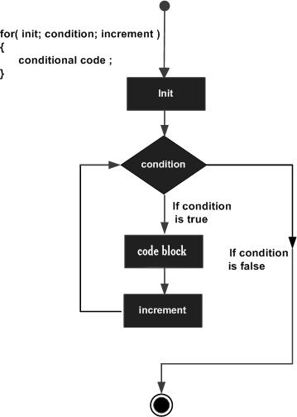
1) for loop…

Slide 10
1) for loop…
#include <iostream>
using namespace std;
int main() {
for (int i = 0 ; i< 5 ; i++)
{
cout << i << "\n";
}
return 0;
}
Output:
0
1
2
3
4

Slide 11
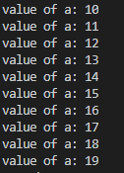
1) for loop…
#include <iostream>
using namespace std;
int main ()
{
// for loop execution
for( int a = 10 ; a < 20; a++ )
{
cout << "value of a: " << a << endl ;
}
return 0;
}

Slide 12
1) for loop…
#include <iostream>
using namespace std;
int main ()
{
for( int a = 0; a < =10; a++ )
{
cout << "value of a: " << a << endl;
}
return 0;
}
Output:
value of a: 0
value of a: 1
value of a: 2
value of a: 3
value of a: 4
value of a: 5
value of a: 6
value of a: 7
value of a: 8
value of a: 9
Value of a: 10

Slide 13

1) for loop…
#include <iostream>
using namespace std;
int main() {
for (int i = 0 ; i <= 10; i = i + 2)
{
cout << i << "\n";
}
return 0;
}

Slide 14
infinitive for loop
If you use two semicolons (; ;) in the for loop it will be infinitive for loop.
#include <iostream>
using namespace std;
int main () {
for (;;)
{
cout<<“infinitive for loop";
}
return 0;
}

Slide 15
for loop Tasks
Write a C++ program which display first 10 number using for loop.
Write a C++ program which display even and odd number using for loop.
Take a number from user and make a table of that number using for loop.
Take a number from user and find factorial of that number using for loop.

Slide 16
2) while loop
Is used when number of iteration is not fixed.
A while loop statement repeatedly executes a target statement as long as a given condition is true.

Slide 17
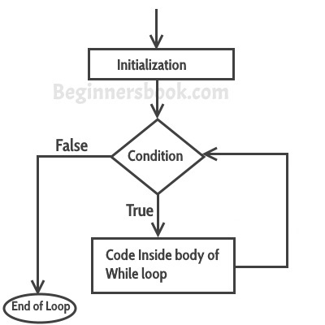
2) while loop
Syntax
initialization;
while(condition)
{
statement(s);
inc/dec;
}
1
2
5
3
4

Slide 18
2) while loop
Here, statement(s) may be a single statement or a block of statements. The condition may be any expression, and true is any non-zero value. The loop iterates while the condition is true.
When the condition becomes false, program control passes to the line immediately following the loop.

Slide 19
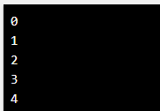
2) while loop…
#include <iostream>
using namespace std;
int main() {
int i = 0;
while (i < 5) {
cout << i << "\n";
i++;
}
return 0;
}
Note: Do not forget to increase the variable used in the condition, otherwise the loop will never end!

Slide 20
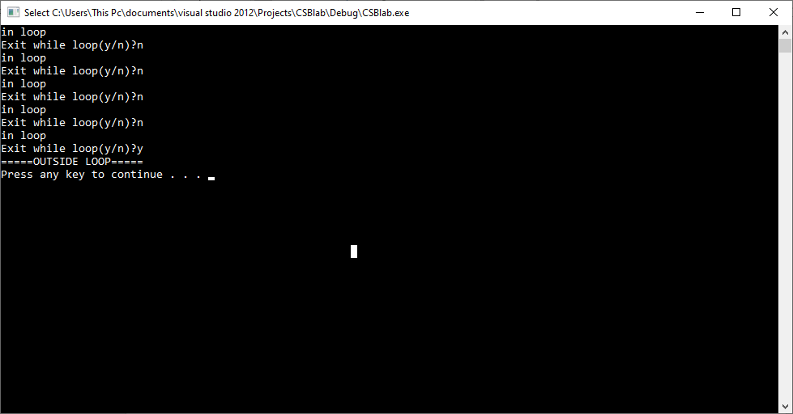
2) while loop…
#include <iostream>
using namespace std;
int main () {
// Local variable declaration:
char c = 'n';
// while loop execution
while( c !='y' )
{
cout << "in loop"<<endl;
cout<<"Exit while loop(y/n)?";
cin>>c;
}
cout<<"=====OUTSIDE LOOP====="<<endl;
return 0;
}
Sentinel Condition: Truthfulness or falseness depends upon user input.

Slide 21
infinitive while loop
If you pass true or true value in the while loop, it will be infinitive while loop.
Syntax:
while(true)
{
Statement(s);
}

Slide 22
infinitive while loop…
#include <iostream>
using namespace std;
int main () {
while(true)
{
cout<<"infinitive while loop";
}
return 0;
}

Slide 23
while loop Tasks
Write a C++ program which display first 10 number using while loop.
Write a C++ program which display even and odd number using while loop.
Take a number from user and make a table of that number using while loop.
Take a number from user and find factorial of that number using while loop.
Make a calculator using if-else-if else statement which perform addition, subtraction, multiplication, division and remainder operations. Take values and operator from user on runtime. Use while loop for user choice. Means after performing one operation program will ask from user “do you want to do another calculation(yes/no)? ”. If user press yes then user will enter number 1, number 2 and operator for calculation and if user press no then terminate the loop.

Slide 24
3) do while loop
An indefinite loop. Best used when the number of iteration is unknown.
Used when you will execute the loop at least once.
Unlike for and while loops, which test the loop condition at the top of the loop, the do...while loop checks its condition at the bottom of the loop.
A do...while loop is similar to a while loop, except that a do...while loop is guaranteed to execute at least one time.

Slide 25
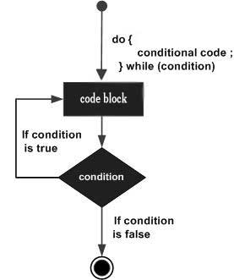
3) do while loop…
Syntax
initialization;
do
{
statement(s);
inc/dec;
}
while(condition) ;

Slide 26
3) do while loop…
Notice that the conditional expression appears at the end of the loop, so the statement(s) in the loop execute once before the condition is tested.
If the condition is true, the flow of control jumps back up to do, and the statement(s) in the loop execute again. This process repeats until the given condition becomes false.

Slide 27
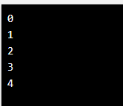
3) do while loop…
#include <iostream>
using namespace std;
int main() {
int i = 0;
do {
cout << i << "\n";
i++;
}
while (i < 5);
return 0;
}
Do not forget to increase the variable used in the condition, otherwise the loop will never end!

Slide 28
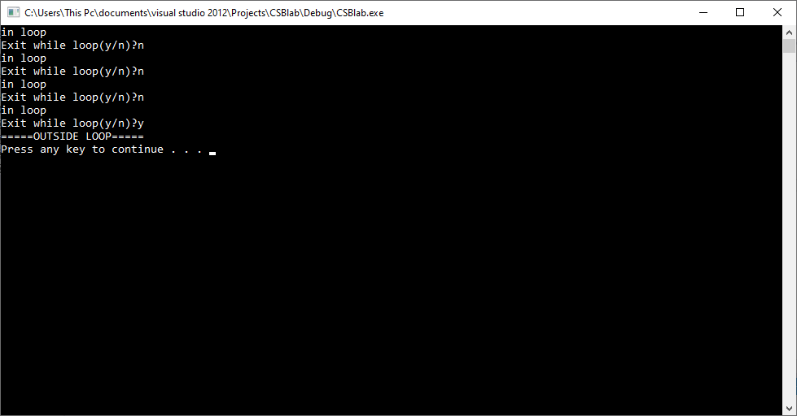
3) do while loop…
#include <iostream>
using namespace std;
int main ()
{
// Local variable declaration:
char c ; // do-while loop execution
do
{
cout << "in loop"<<endl;
cout<<"Exit while loop(y/n)?";
cin>>c;
}
while( c !='y' );
cout<<"=====OUTSIDE LOOP====="<<endl;
return 0;
}

Slide 29
infinitive do while loop
If you pass true or true value in the do while loop, it will be infinitive do while loop.
Syntax:
do
{
Statement(s);
}
while(true);

Slide 30
infinitive do while loop…
#include <iostream>
using namespace std;
int main () {
while(true)
{
cout<<"infinitive do while loop";
}
return 0;
}

Slide 31
do while loop Tasks
Write a C++ program which display first 10 number using do while loop.
Write a C++ program which display even and odd number using while loop.
Take a number from user and make a table of that number using do while loop.
Take a number from user and find factorial of that number using do while loop.
Make a calculator using if-else-if else statement which perform addition, subtraction, multiplication, division and remainder operations. Take values and operator from user on runtime. Use do while loop for user choice. Means after performing one operation program will ask from user “do you want to do another calculation(yes/no)? ”. If user press yes then user will enter number 1, number 2 and operator for calculation and if user press no then terminate the loop.

Slide 32
Enhanced for loop (for-each loop )
Works with array.
Is used for traversing an array.
It is easy to use than simple for loop because here we do not need initialization of counter variable, condition and incrementation or decrementation of counter variable.
Syntax
for (datatype variable-name : arrayname)
{ statement(s); }
Data type must be same as that of array data type

Slide 33
Enhanced for loop (for-each loop )…
#include<iostream>
using namespace std;
int main()
{
int arr[]={1,2,3,4,5}; //array initialization
cout<<"The elements are: ";
for(int i : arr)
{
cout<<i<<" ";
}
return 0;
}

Slide 34
Break Statement
The break statement terminates the execution of the loop when it is used inside the body of the loop.
Syntax: break;
The break statement can also be used to jump out of a loop.

Slide 35
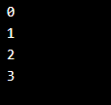
Break Statement Example
This example jumps out of the loop when i is equal to 4:
#include <iostream>
using namespace std;
int main() {
for (int i = 0; i <10; i++)
{
if (i == 4) {
break;
}
cout << i << "\n";
}
return 0;
}

Slide 36
Continue Statement
The continue statement shifts the control back to the beginning of the loop.
It is used inside the body of the loop.
It is used to continue loop.
It continues the current flow of the program and skips the remaining code at specified condition.
Syntax: continue;

Slide 37
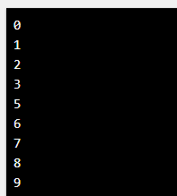
Continue Statement Example: Use of continue in for loop
#include <iostream>
using namespace std;
int main() {
for (int i = 0; i < 10; i++)
{
if (i == 4) {
continue;
}
cout << i << "\n";
}
return 0;
}

Slide 38
Nested Loop
Loop within the body of another loop is called nested loop.

Slide 39
Nested for loop
Program 1: (Triangular loop which make triangle using for nested loop with help of asterisks (*)).
*
**
***
****
*****

Slide 40

Nested for loop…
#include <iostream>
using namespace std;
int main () {
for (int i=1 ; i<=5 ; i++)
{
for (int j=0 ; j<i ; j++)
{
cout<<"*";
}
cout<<endl;
}
return 0;
}

Slide 41
Nested for loop…
Program 2: (Triangular loop which make triangle using for nested loop with help of numbers).
1
1 2
1 2 3
1 2 3 4
1 2 3 4 5

Slide 42

Nested for loop…
#include <iostream>
using namespace std;
int main () {
for (int i=1 ; i<=5 ; i++)
{
for (int j=1 ; j<=i ; j++)
{
cout<<j;
cout<<" ";
}
cout<<endl;
}
return 0;
}

Slide 43
Nested for loop tasks
Write a C++ program that will display * in the following pattern.
*****
****
***
**
*
2. Write a C++ program that will display numbers in the following pattern.
1 2 3 4 5
1 2 3 4
1 2 3
1 2
1

Slide 44
Nested for loop tasks…
3. Write a C++ program to print the output as shown below. Use “setw” manipulator.
*
**
*****
*******
4. Write a C++ program to print the output as given below by using the “for” loop structure and “setw” manipulator.
XXXXX
XXXX
XXX
XX
X

Slide 45
Summary
1 | for loop Execute a sequence of statements multiple times and abbreviates the code that manages the loop variable.
2 | while loop Repeats a statement or group of statements while a given condition is true. It tests the condition before executing the loop body.
3 | do...while loop Like a ‘while’ statement, except that it tests the condition at the end of the loop body.
4 | nested loops You can use one or more loop inside any another ‘while’, ‘for’ or ‘do..while’ loop.

Slide 46
References
https://beginnersbook.com/2017/08/cpp-data-types/
https://www.geeksforgeeks.org/c-data-types/
http://www.cplusplus.com/doc/tutorial/basic_io/
https://www.geeksforgeeks.org/basic-input-output-c/
https://www.w3schools.com/cpp/default.asp
https://www.javatpoint.com/cpp-tutorial

Slide 47

THANK YOU
Thanks

